Slide 1



Apomee Ecommerce APp
2
+
2
+
MD MEHEDI HASAN

Slide 2


Specs:
2
+
2
+
Android Studio: 3.5
Compile SDK Ver: 28
Mininum SDK Ver: 23
Target SDK Ver: 28
→AndroidX Artifacts

Slide 3
Library Modules:
2
+
2
+
→Firebase
→Paper
→Picasso
→Image Cropper
→Circle ImageView
→Elegant Button

Slide 4

Features:
2
+
1. Firebase Integration

Slide 5
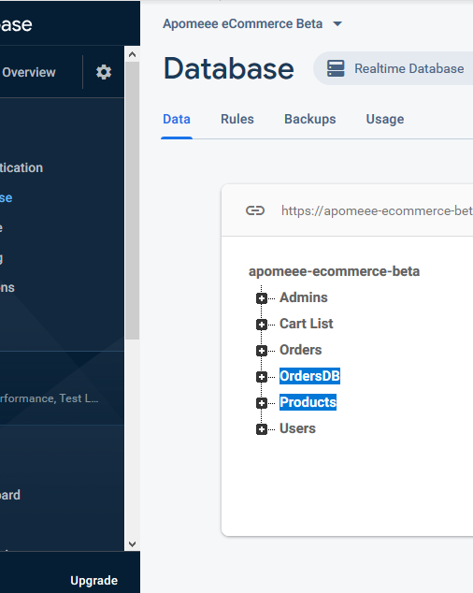
Features:
2
+
1. Firebase Integration

Slide 6
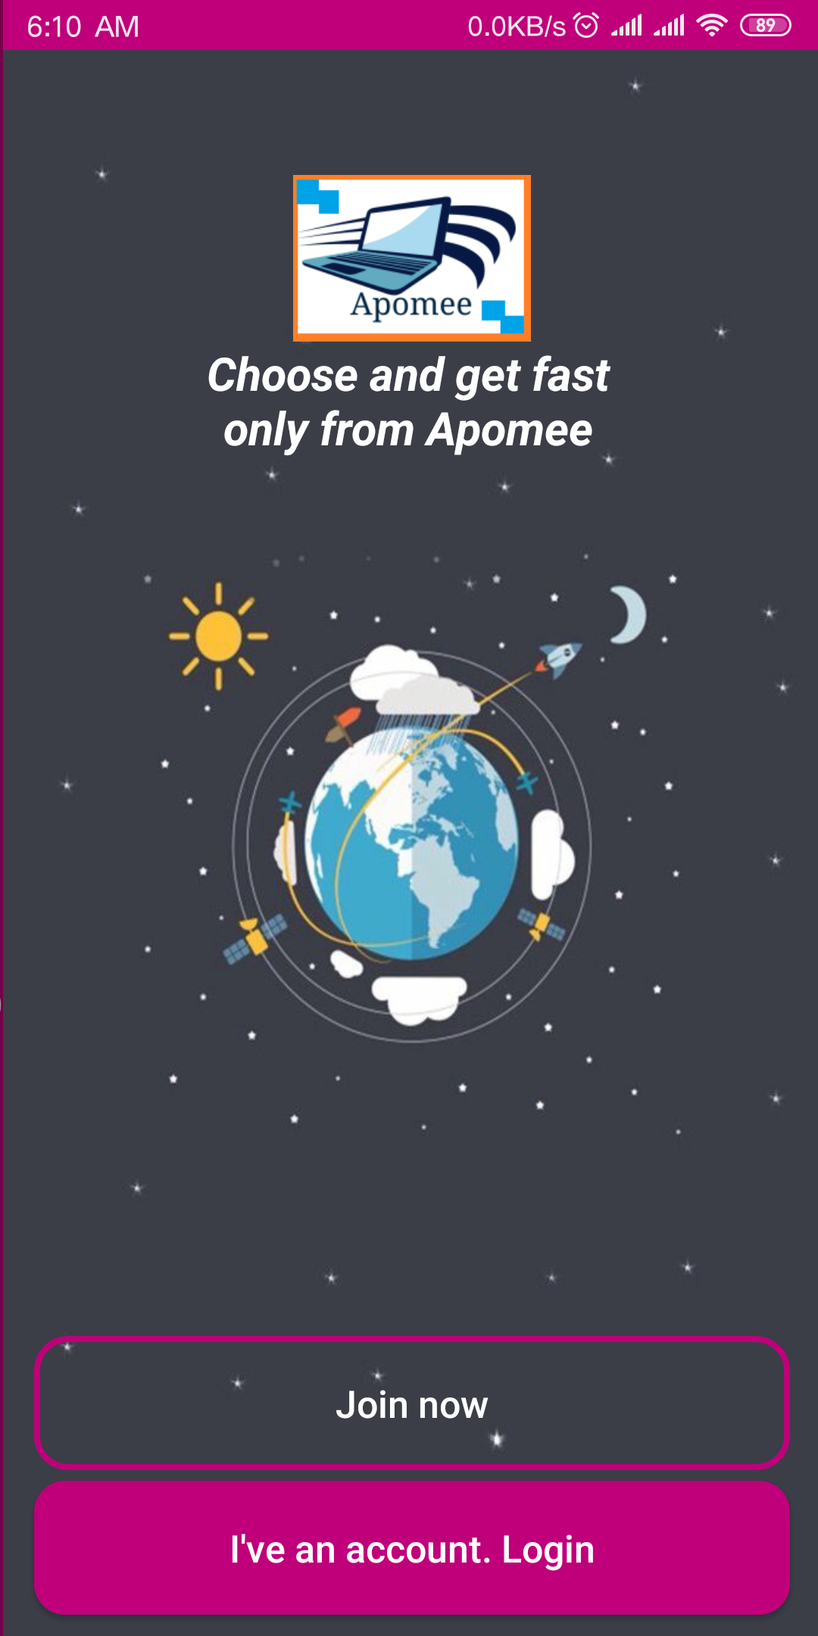
Features:
2
+
Firebase Integration
User Friendly MainActivity

Slide 7
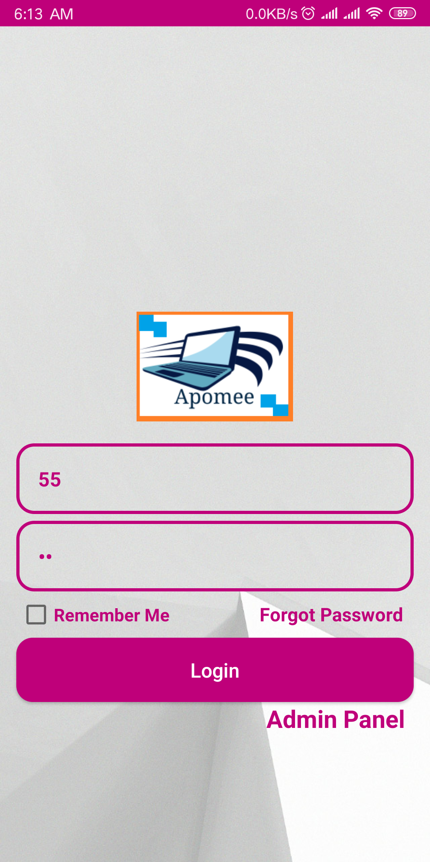
Features:
2
+
Firebase Integration
User Friendly Main Activity
Login/Join

Slide 8
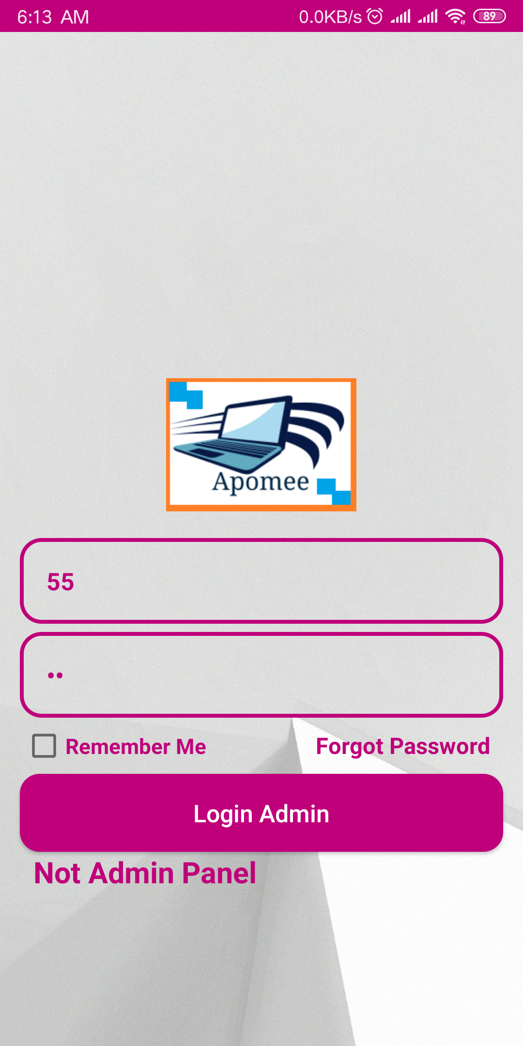
Features:
2
+
Firebase Integration
User Friendly Main Activity
Login/Join

Slide 9
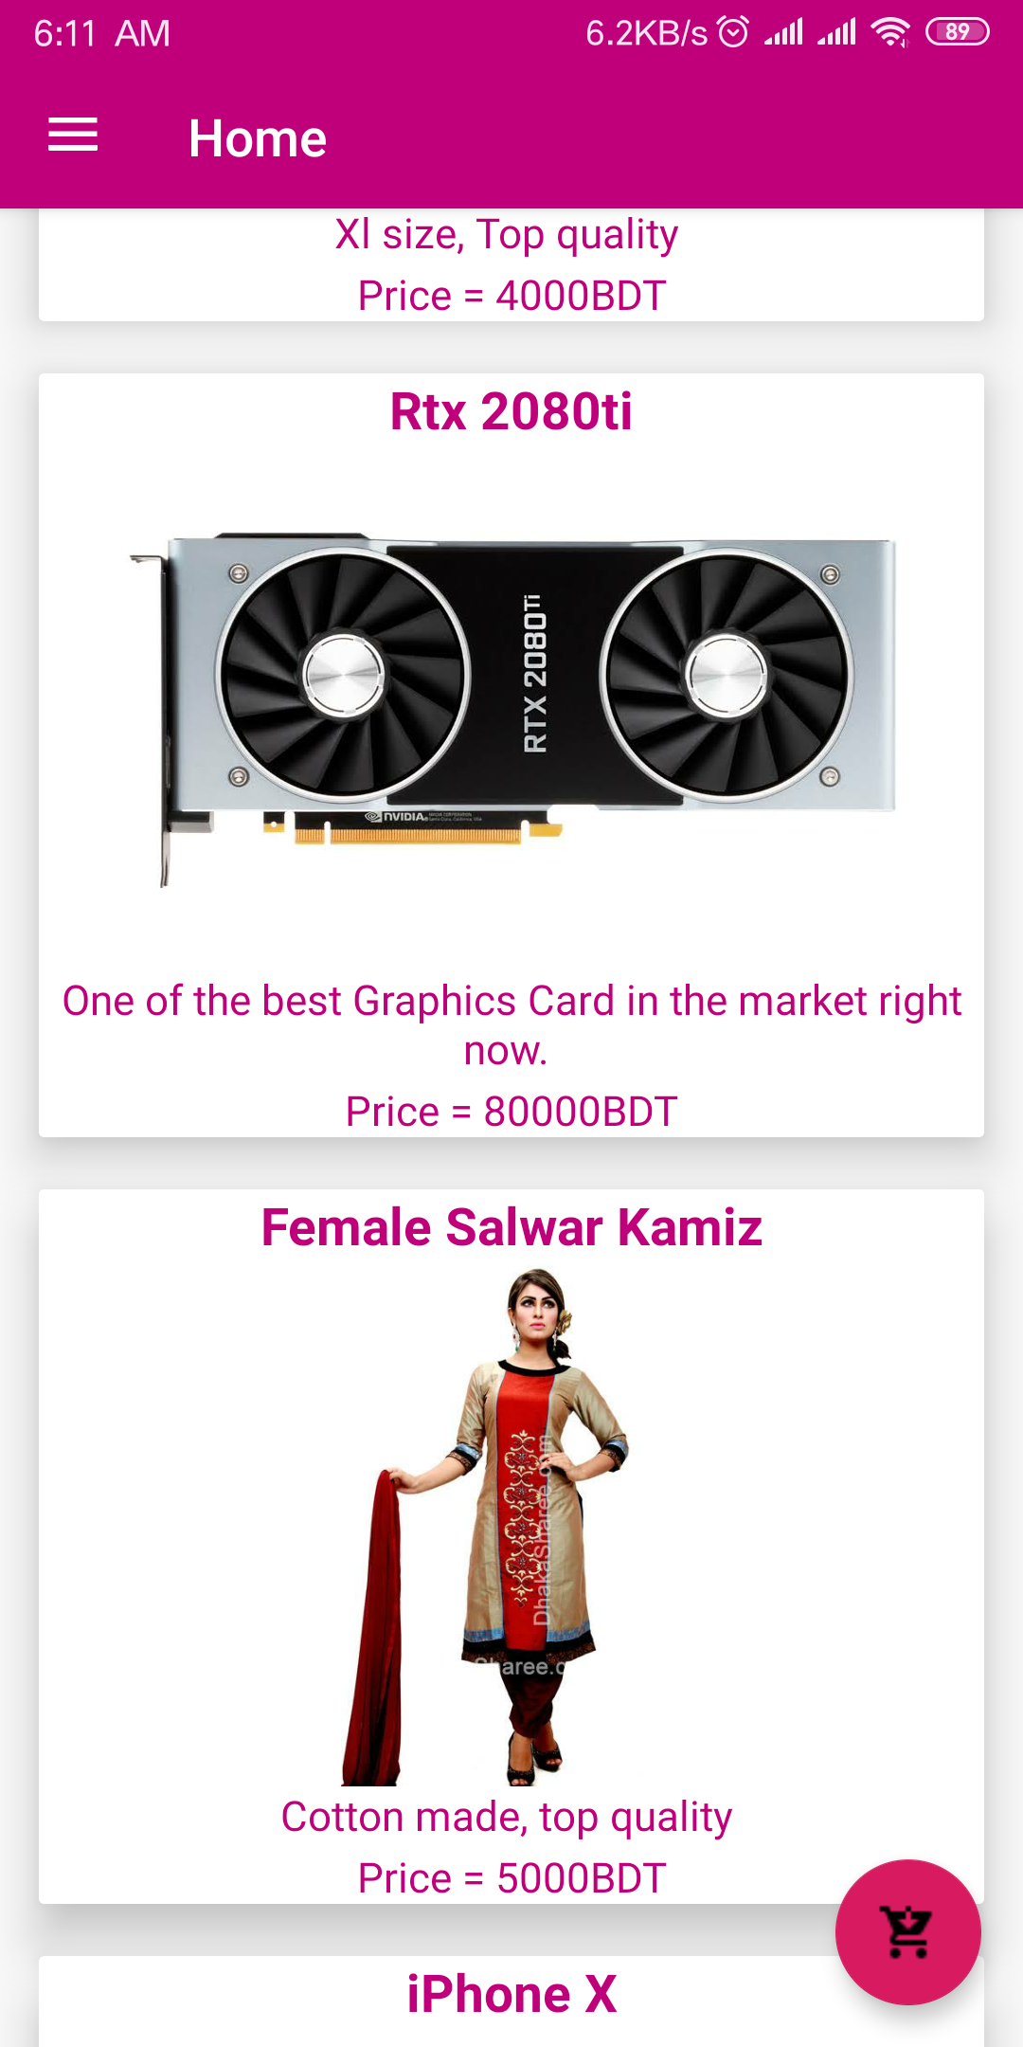
Features:
2
+
Firebase Integration
User Friendly Main Activity
Login/Join
RecyclerView for Products

Slide 10
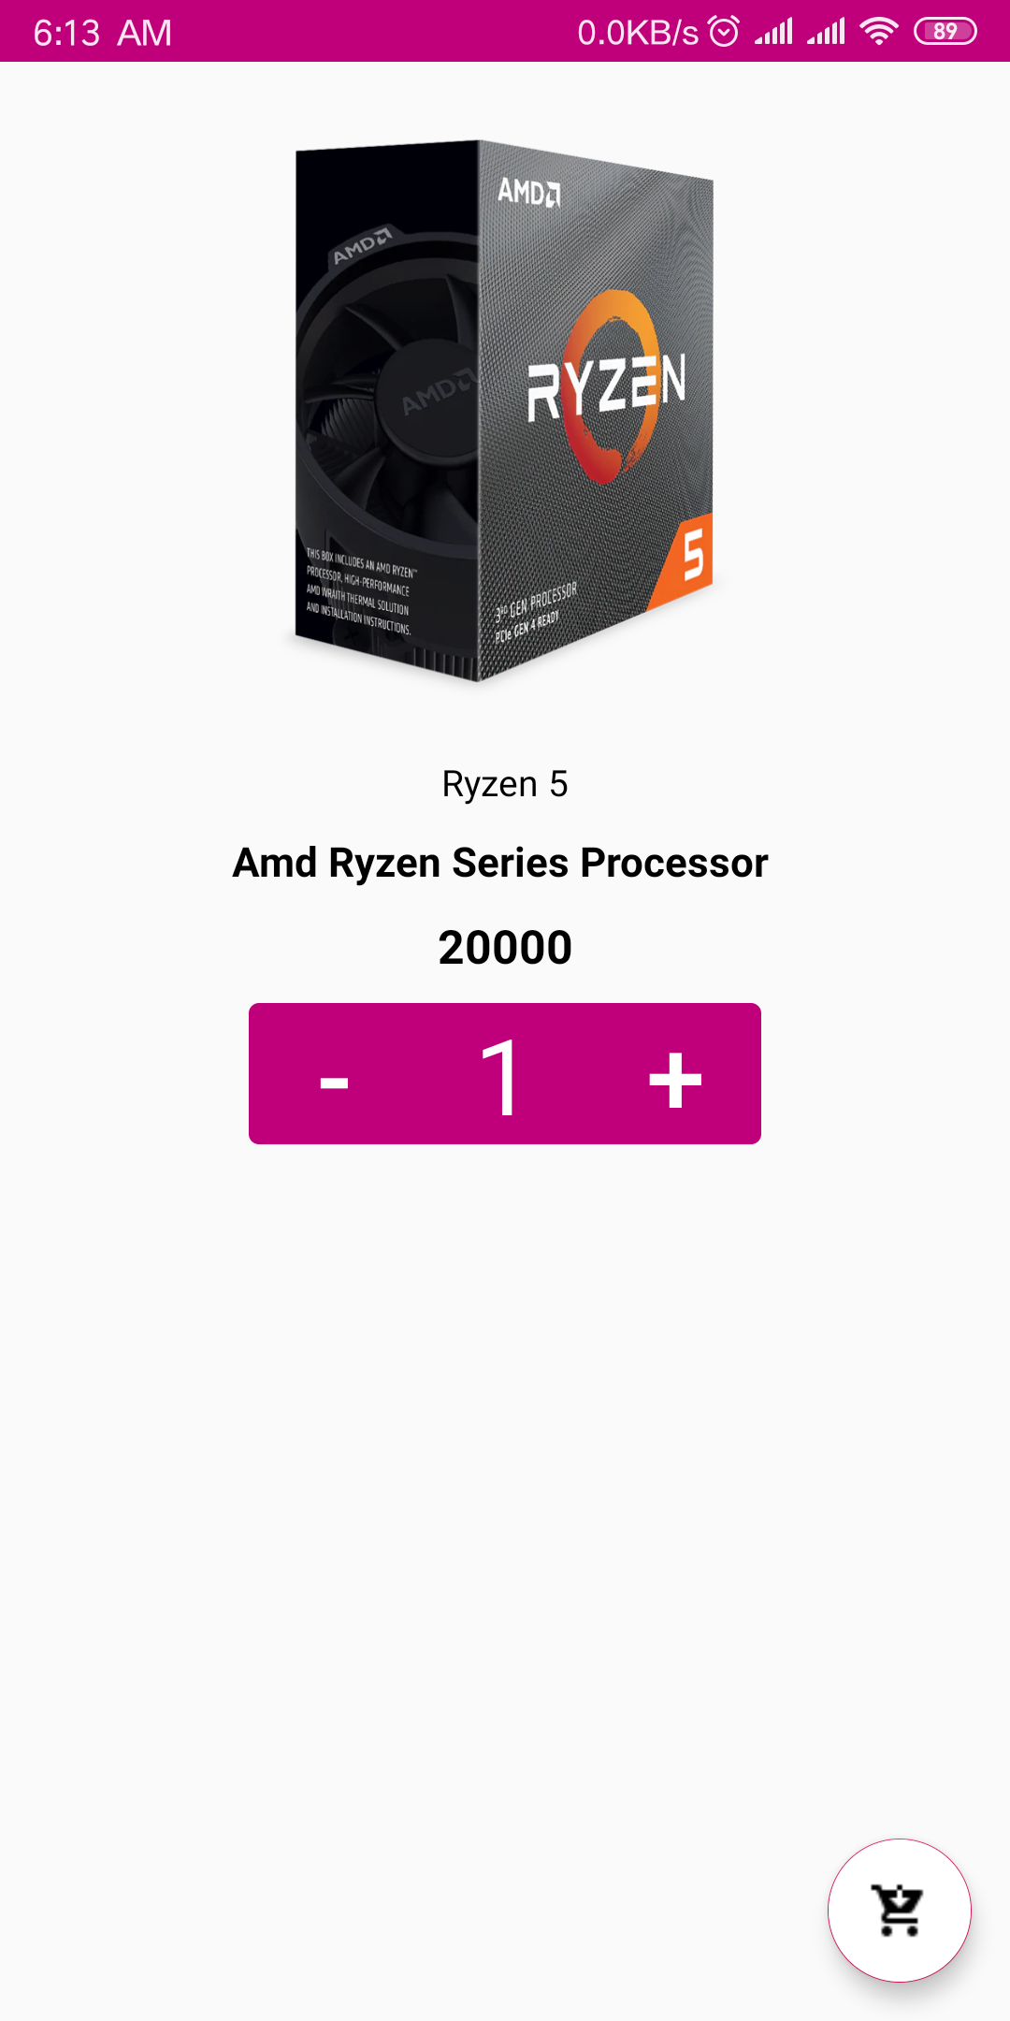
Features:
2
+
Firebase Integration
User Friendly Main Activity
Login/Join
RecyclerView for Products
Order through cart.

Slide 11
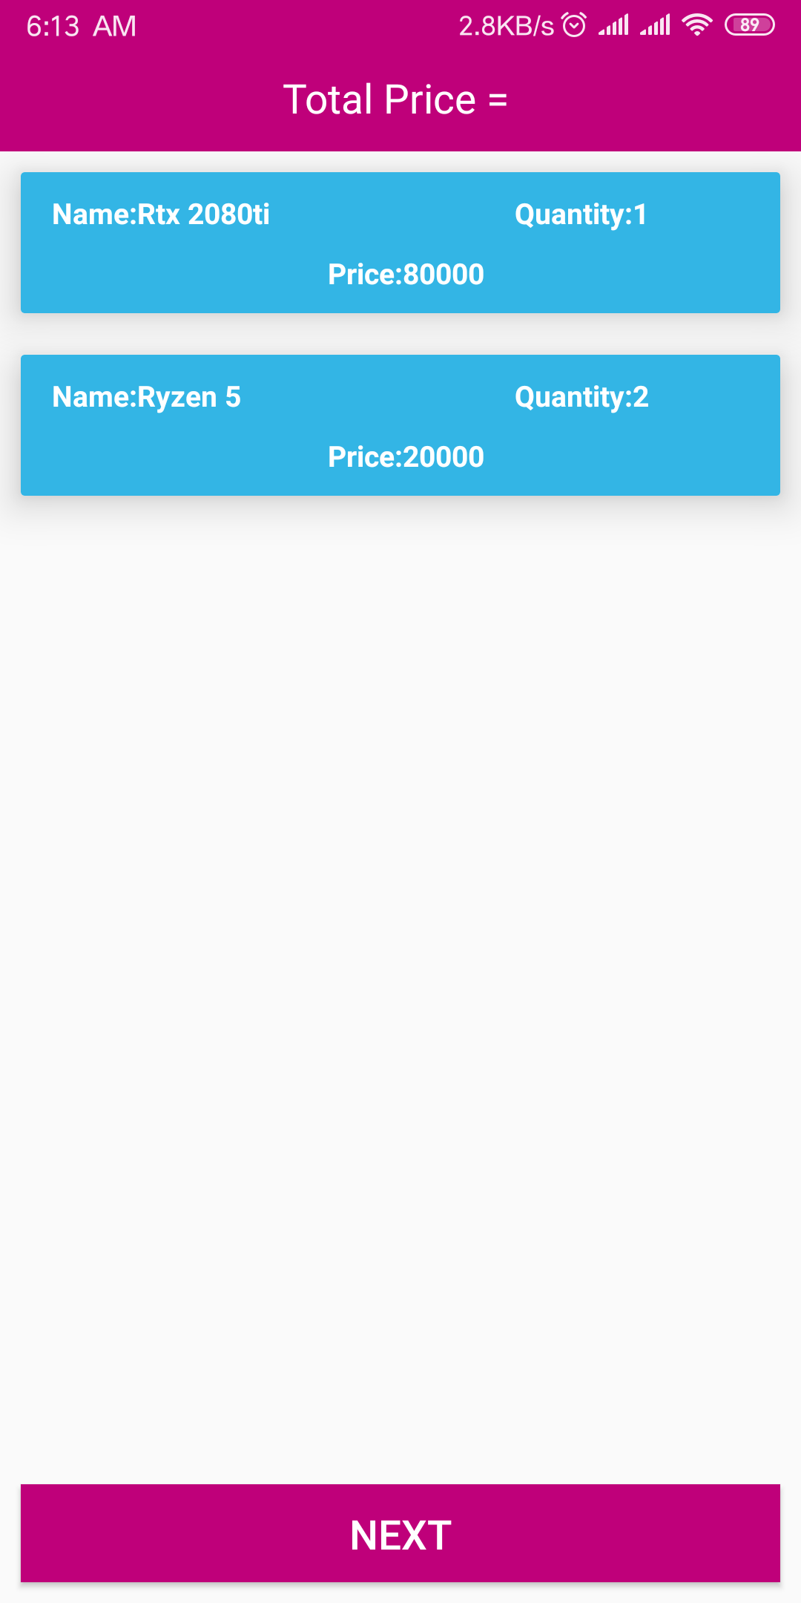
Features:
2
+
Firebase Integration
User Friendly Main Activity
Login/Join
RecyclerView for Products
Order through cart.

Slide 12
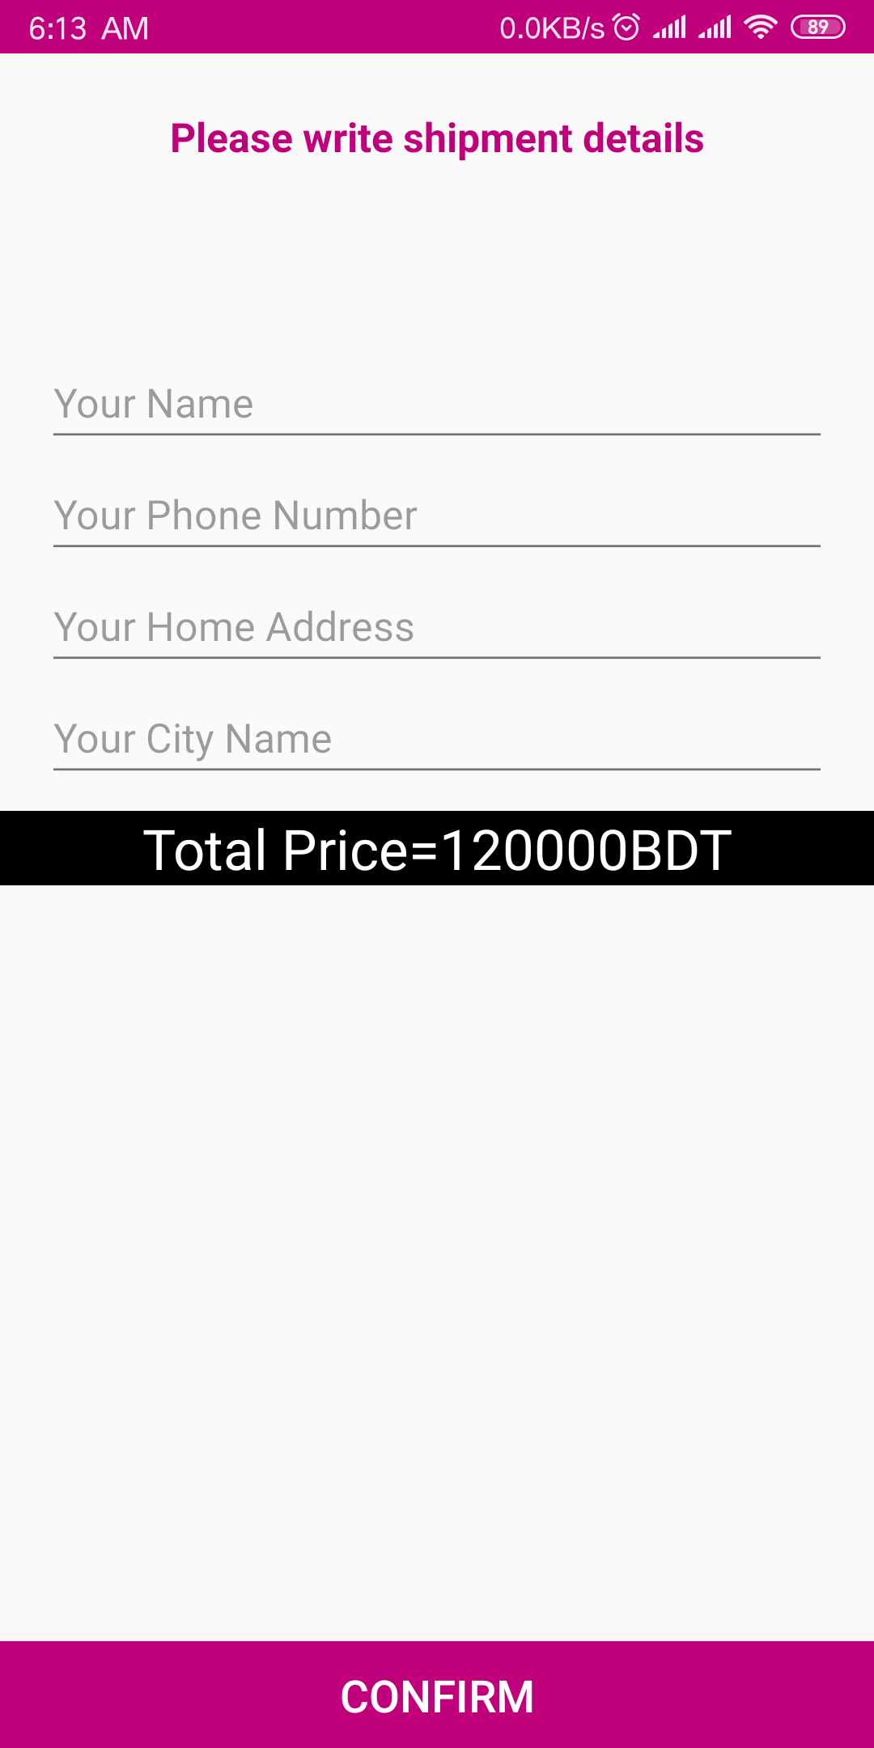
Features:
2
+
Firebase Integration
User Friendly Main Activity
Login/Join
RecyclerView for Products
Order through cart.

Slide 13
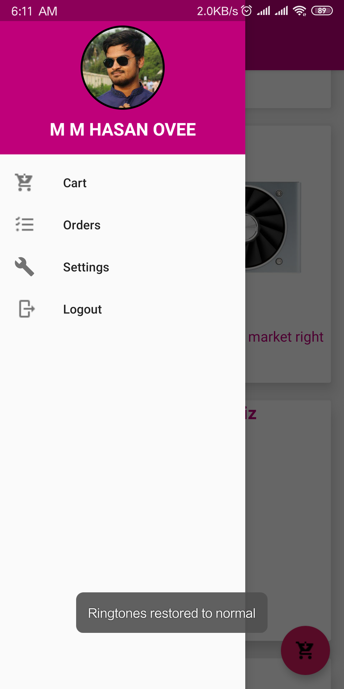
Features:
2
+
6. NavigationVew for User

Slide 14
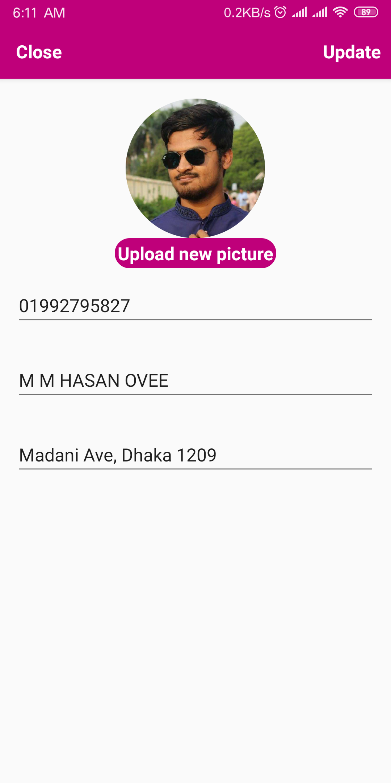
Features:
2
+
6. NavigationVew for User
7. User Settings Update

Slide 15
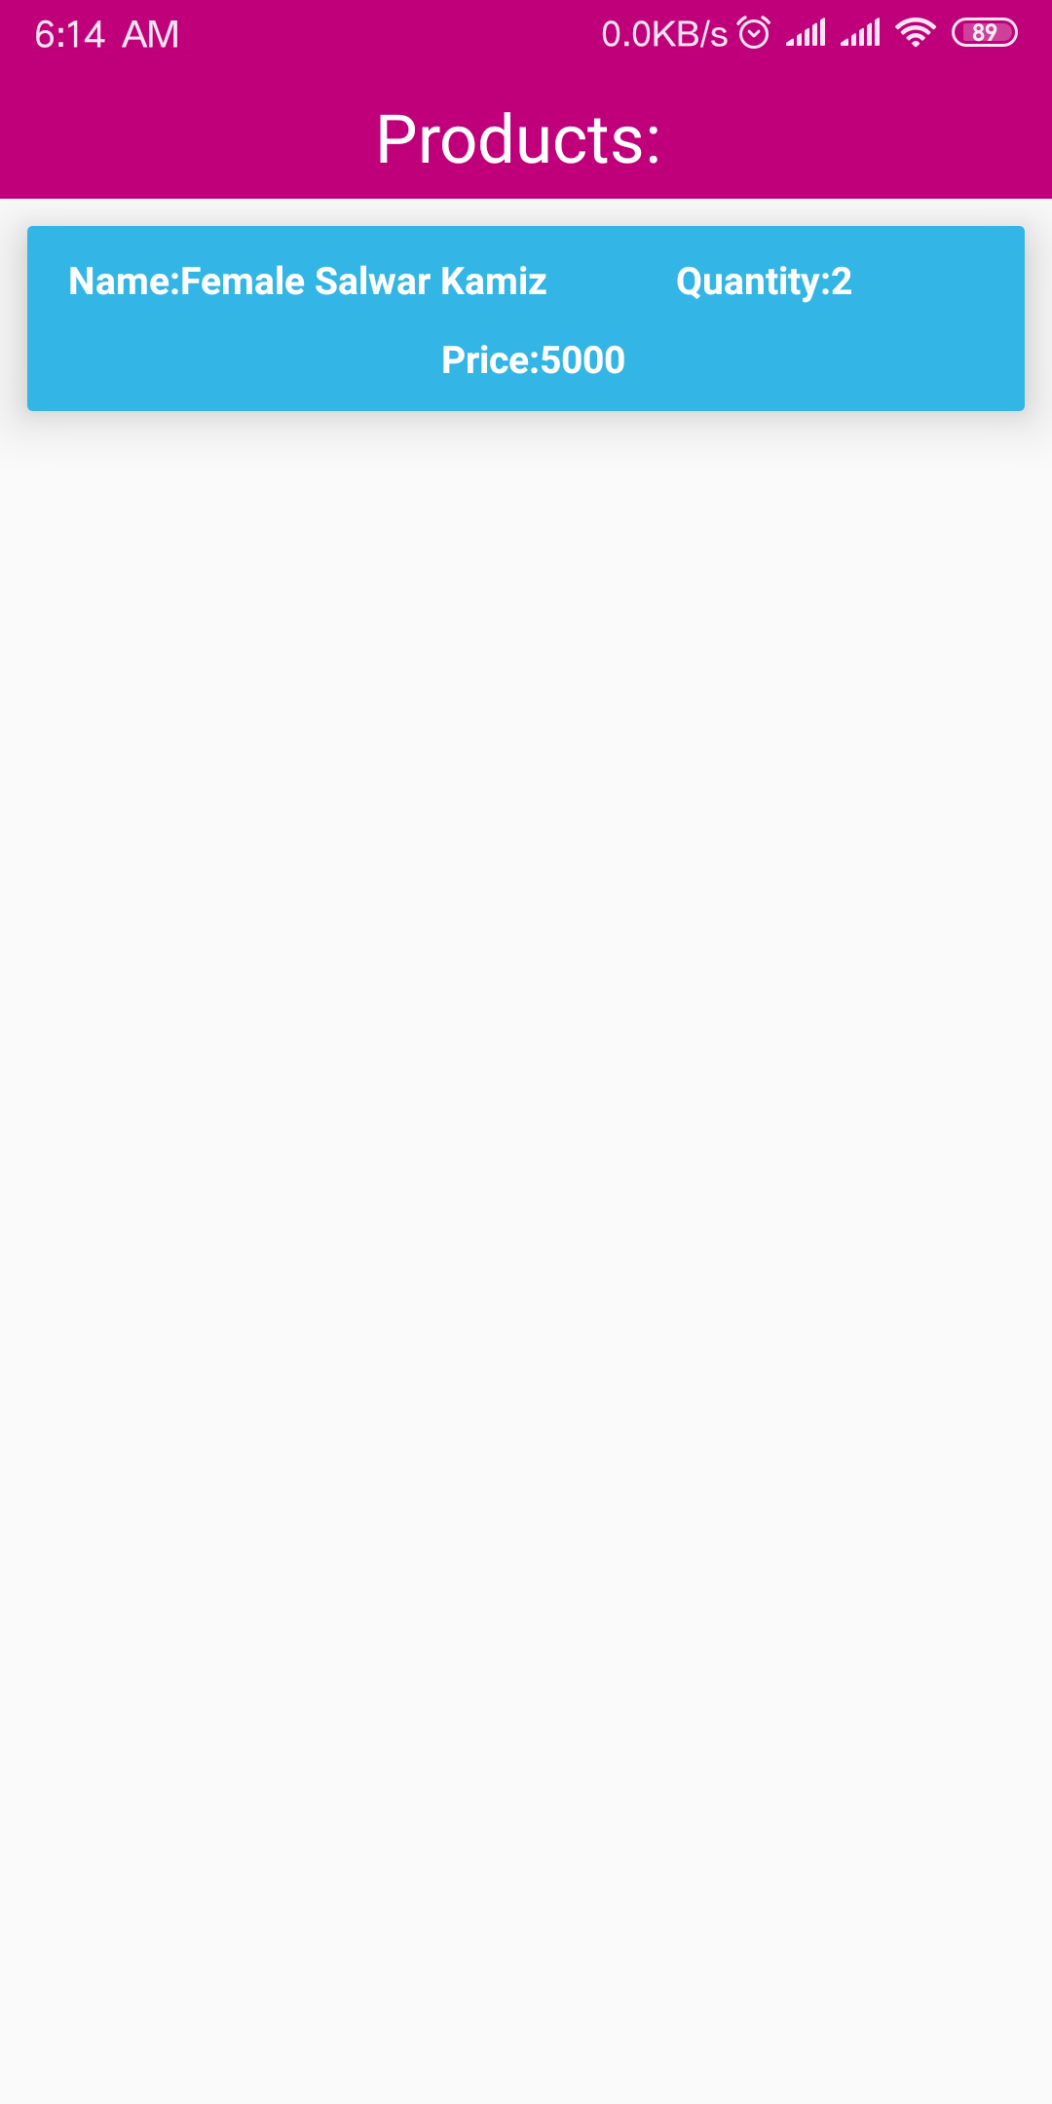
Features:
2
+
6. NavigationVew for User
7. User Settings Update
8. View Placed Orders

Slide 16
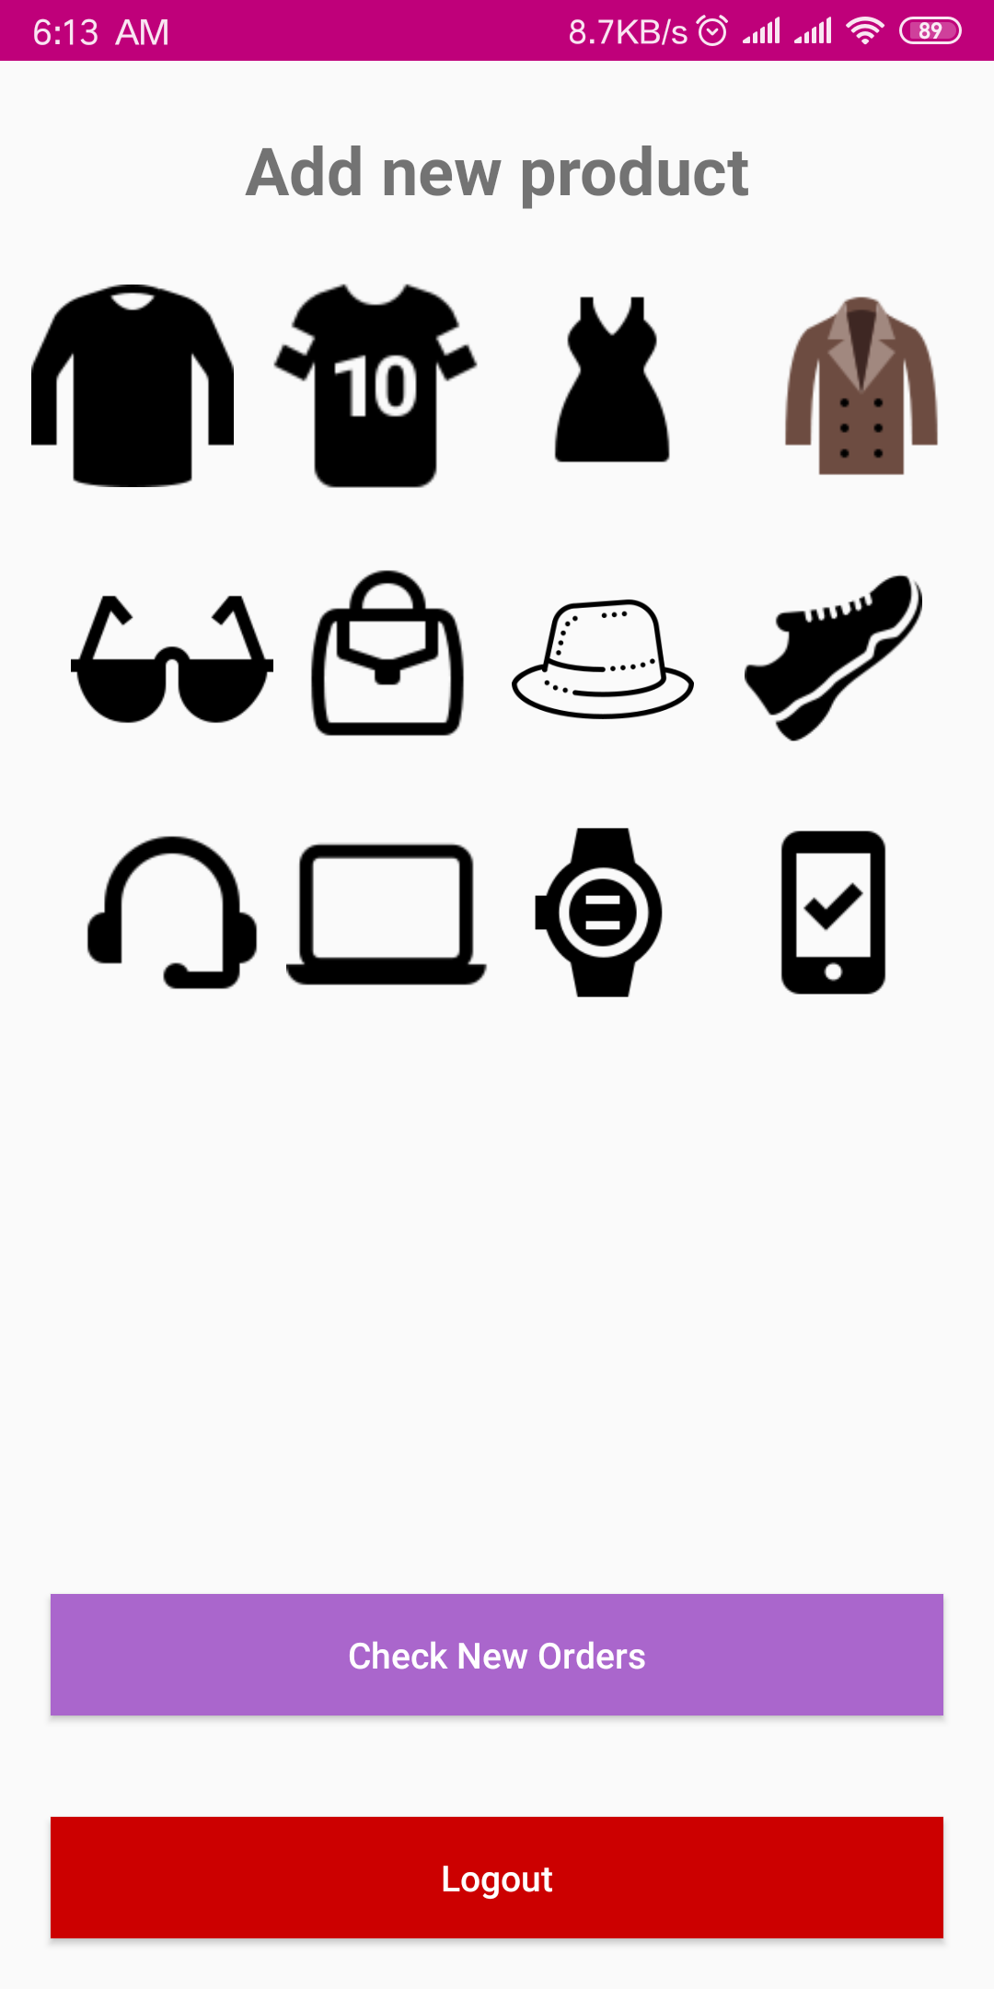
Features:
2
+
6. NavigationVew for User
7. User Settings Update
8. Placed Orders Info
9. Products Upload for
Admin

Slide 17
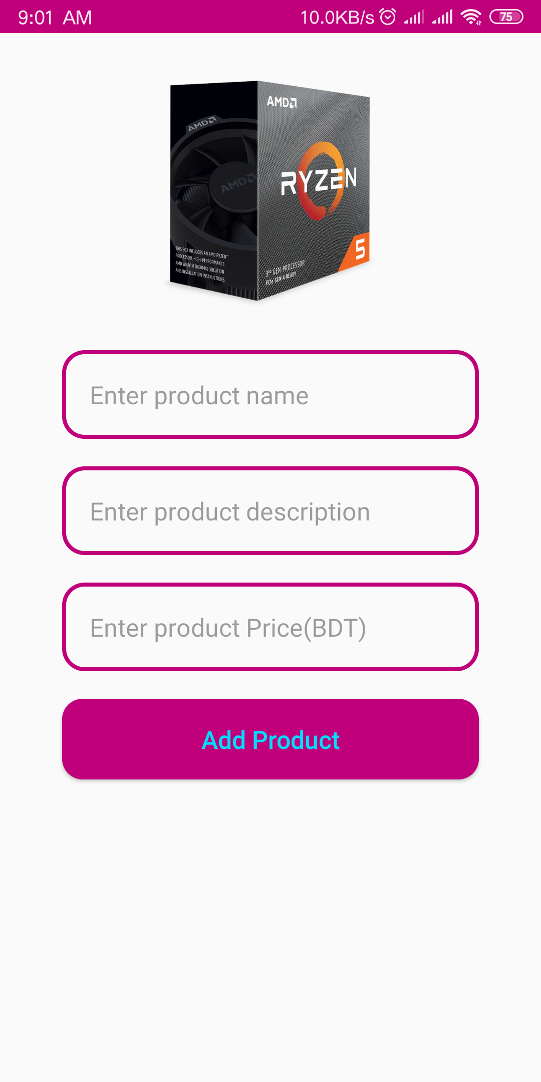
Features:
2
+
6. NavigationVew for User
7. User Settings Update
8. Placed Orders Info
9. Products Upload for
Admin

Slide 18
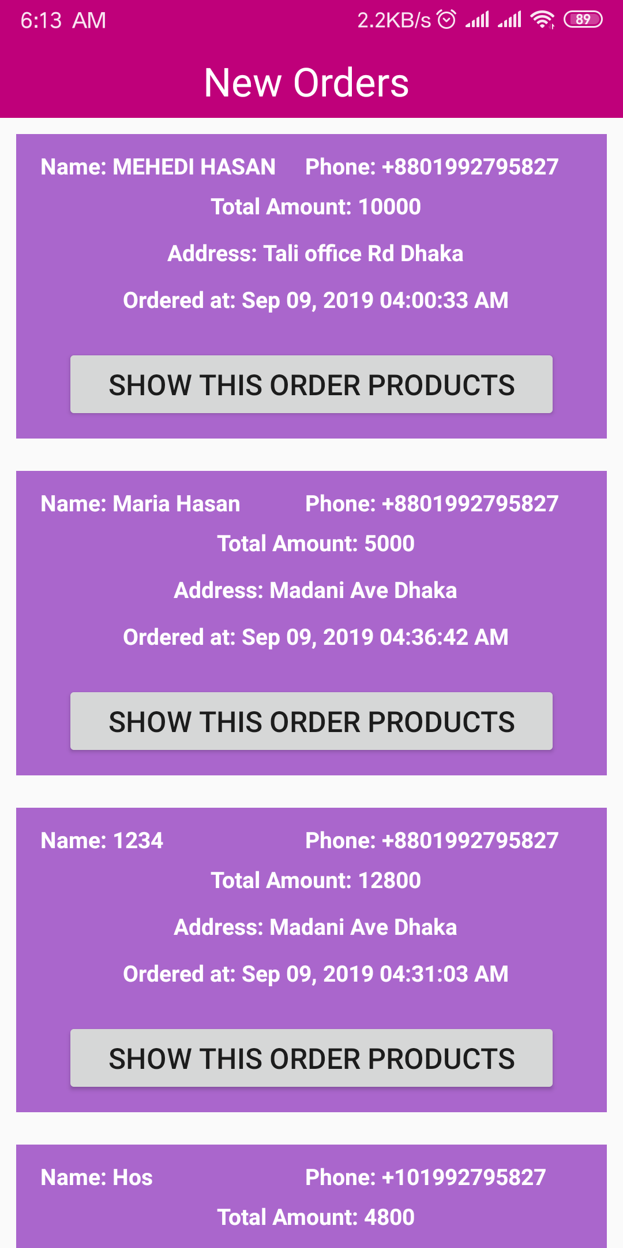
Features:
2
+
6. NavigationVew for User
7. User Settings Update
8. Placed Orders Info
9. Products Upload for
Admin
10. Admin can check
orders and confirm
shipment

Slide 19
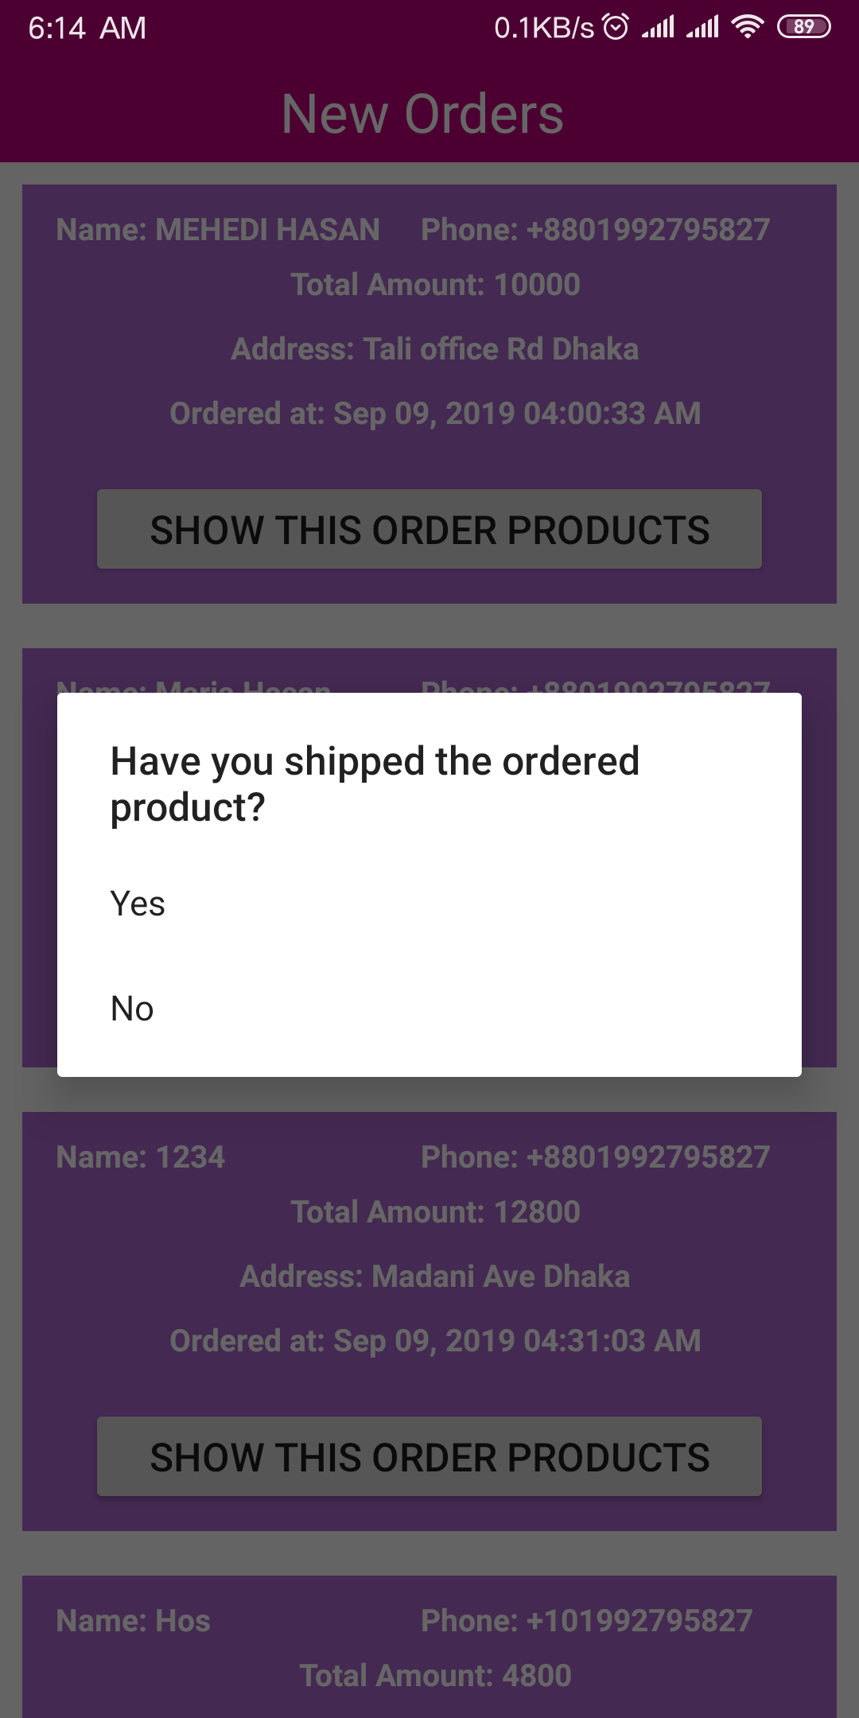
Features:
2
+
6. NavigationVew for User
7. User Settings Update
8. Placed Orders Info
9. Products Upload for
Admin
10. Admin can check
orders and confirm
shipment

Slide 20
Features:
2
+
6. NavigationVew for User
7. User Settings Update
8. Placed Orders Info
9. Products Upload for
Admin
10. Admin can check
orders and confirm
shipment

Slide 21
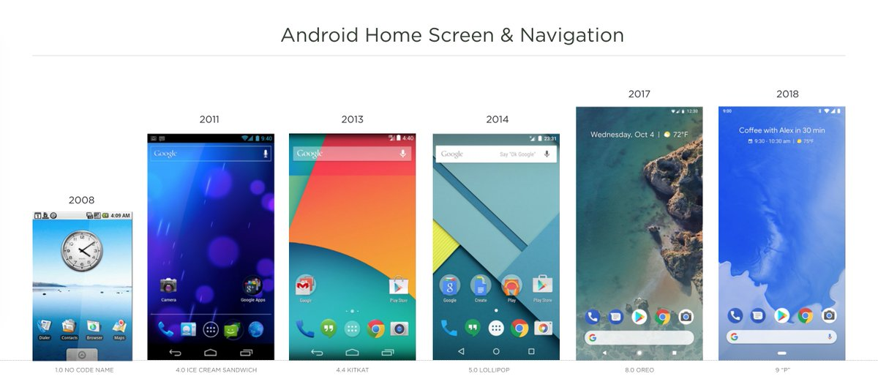
THANK YOU
2
+

